Slide 1
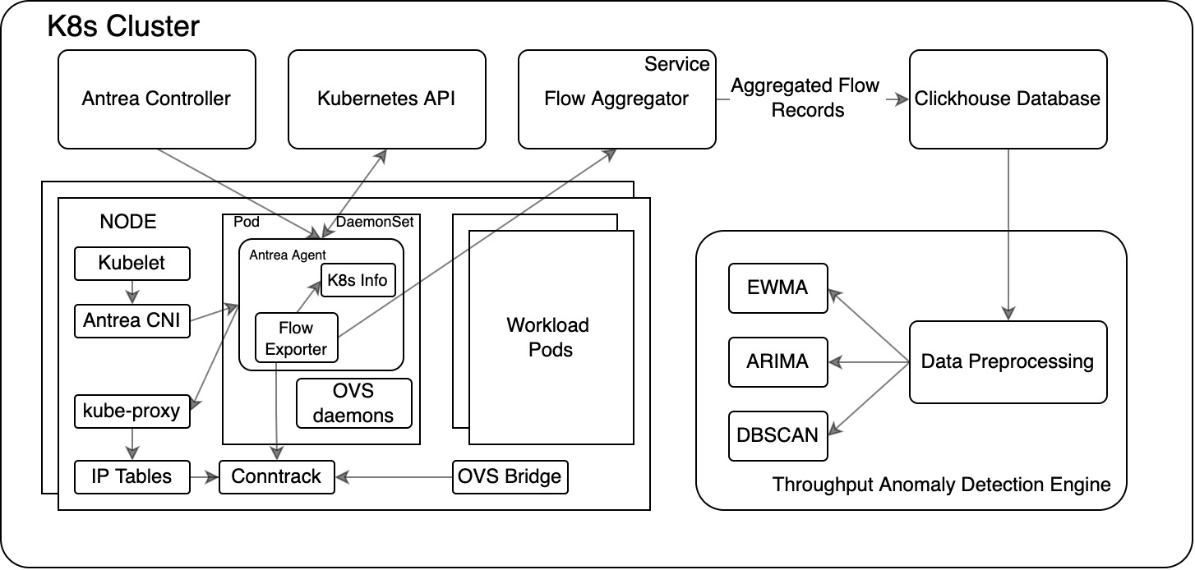
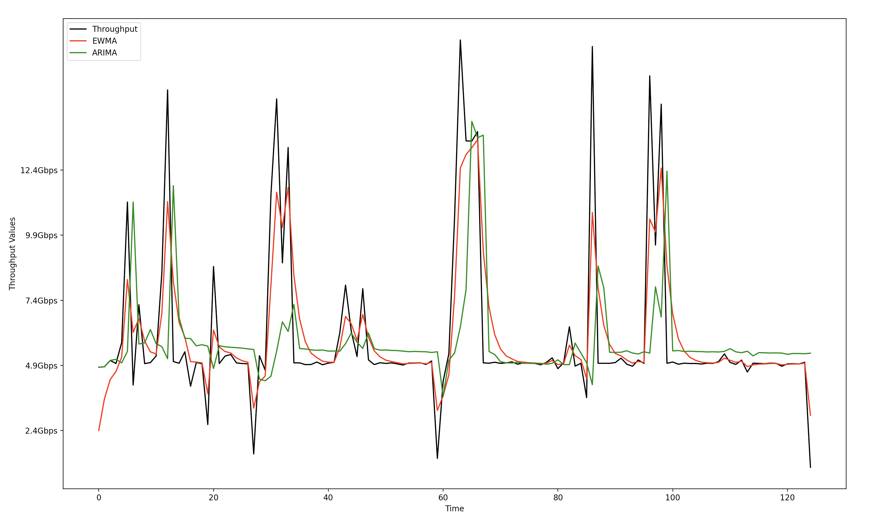
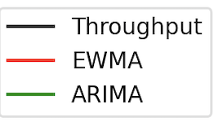
THROUGHPUT ANOMALY DETECTION IN KUBERNETES CLUSER WITH ANTREA
Subramanian Venkataraman, Yongming Ding (Mentor), Salvatore Orlando (Manager)
ARCHITECTURE
MOTIVATION
FUTURE WORK
• RCA for complex network issues – pain point for Network and DevOps Engineers – Identification and understanding the problem.
• Not acting on the anomalies on time results in performance degradation of the application.
• Improve Model performances
• Identify anomalies in real time using Spark Streaming APIs
• Develop CLI commands for user interaction
MY CONTRIBUTION (SO FAR…)
WHAT IS ANTREA?
HITCH
Developed a Spark job to find the anomalies in existing traffic
Implemented multiple Time Series Algorithms – EWMA and ARIMA to identify anomalies and forecast anomalies
• Kubernetes-native CNI offering High-performance and is based on the Open vSwitch project (OVS)
• Uses Flow Exporter Module in every Pod to collect Data to Flow Aggregator
• Performance analytics tool to provide an automated troubleshooting solution
• Input - Network flow data as Time series from ClickhouseDB
Result | EWMA | ARIMA
Accuracy | 93% | 95%
Precision | 33% | 66%
Recall | 50% | 66%
Calculated on a 30 min iPerf3 Traffic of 5Gbps with multiple spike in throughput values

